Slide 1

Capstone Project
Food and Beverages Facebook Pages Analysis
By Dr. Diban

Slide 2
Food & Beverages Facebook Pages
Pollo Tropical
Cracker Barrel
Jet’s Pizza
McDonalds
Eddie Vs Prime Seafood
Burger King
Tim Hortons
Pizza Hut
Grand Lux Café
Chipotle
Potbelly Sandwich Shop
Denny’s
Texas Roadhouse
Carrabbas
Olive Garden
Shake Shack
Wendy’s
Zoe’s Kitchen
Yard House
LongHorn Steakhouse
Bonefish Grill
Papa Johns
Famous Dave’s
Flemings
McDonalds US
Dominos
Luby’s
Chilis
The Cheese Cake Factory
Starbucks
Jamba Juice
Fuddruckers
Jack In The Box
Maggiano’s
Seasons 52
Taco Cabana
IHOP
Taco Bell
Hooters
KFC
Red Robin
Papa Murphy’s Pizza
Del Taco
Wingstop
The Capital Grille
El Pollo Loco
Applebee’s
Bahama Breeze
Outback Steakhouse

Slide 3
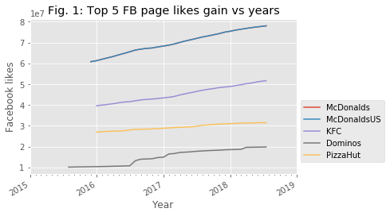
Fastest growing food and beverages Facebook pages

Slide 4
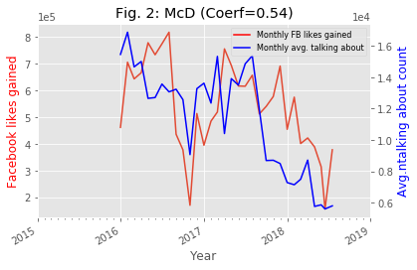
Correlation between monthly Facebook likes gained and average talking about count

Slide 5
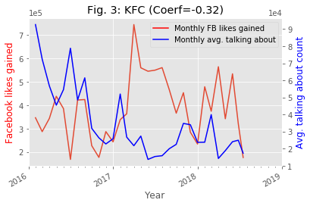
Correlation between monthly Facebook likes gained and average talking about count (contd.)

Slide 6
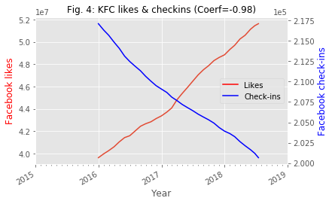
Correlation between Facebook likes gained and check-ins

